Slide 1


Slide 2
Staying Safe

Slide 3
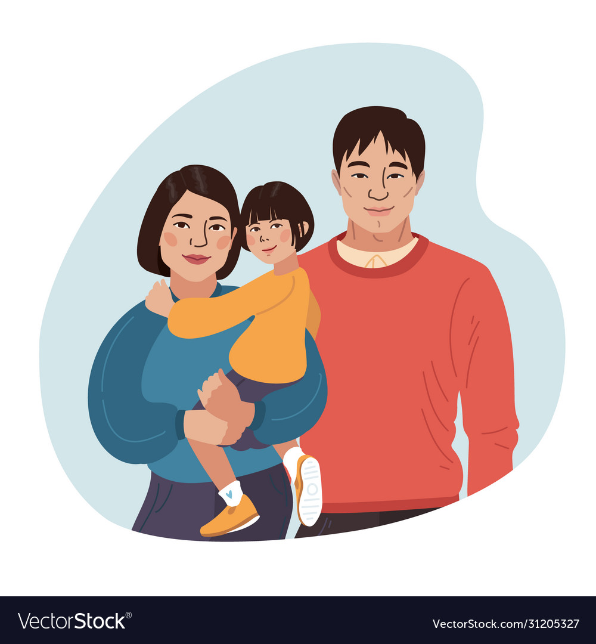


Staying Safe
Talk to adults you can trust- like a uniformed police officer, teacher or parent

Slide 4

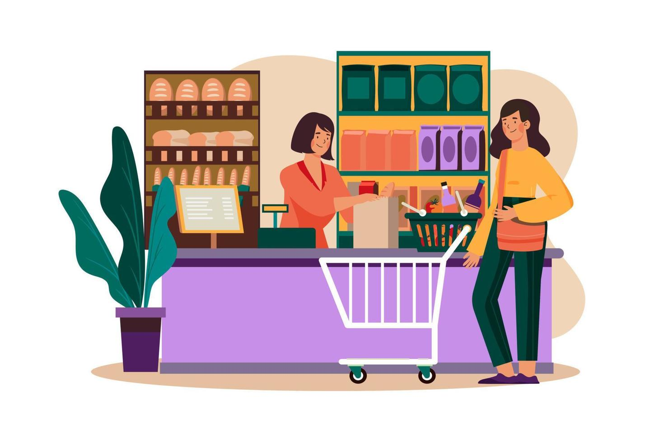
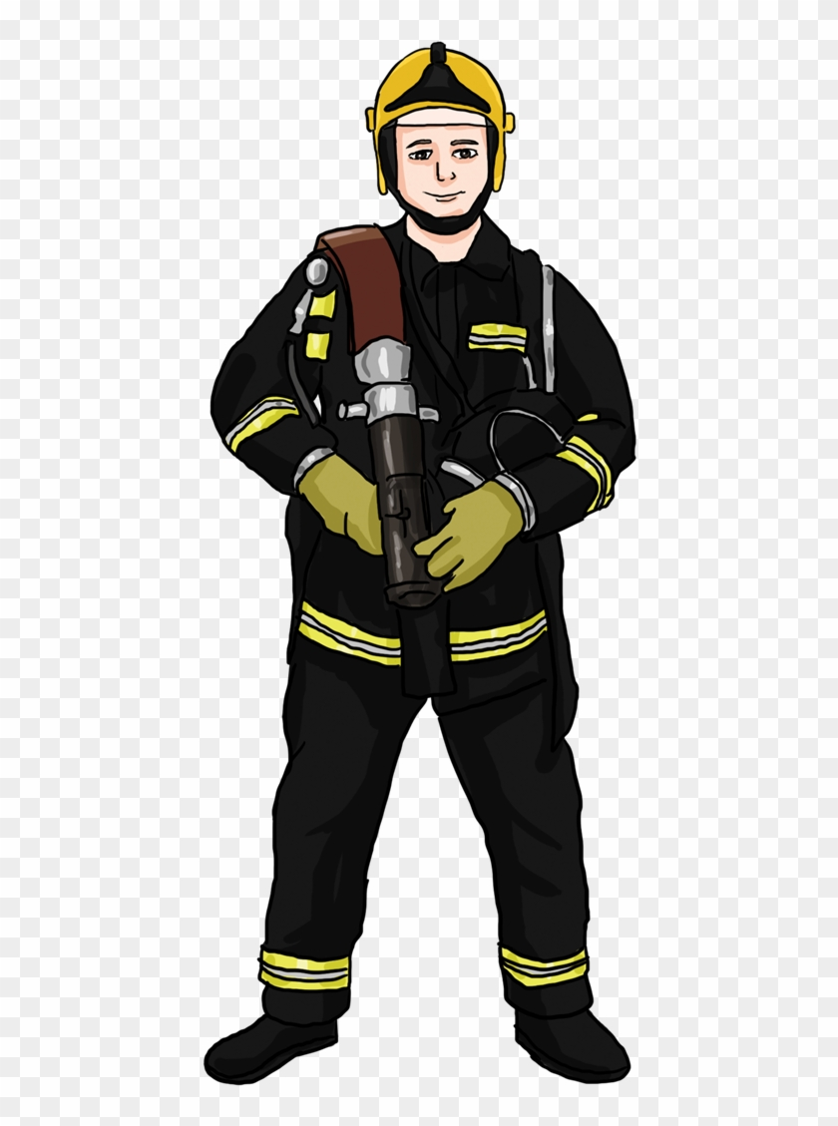
Staying Safe
Other trusted adults are- fire-fighters, nurses, shop assistants

Slide 5
Staying Safe
If you approached by a stranger or if you feel uncomfortable about a situation you must tell a trusted adult.
A stranger is someone you do not know, who is not a trusted adult.

Slide 6
Staying Safe
If you are lost, stay where you are, do not wander off. You will be found more easily if you stay put.
Make a noise, shout ‘Help’, attract attention in some way. This will help bring someone to find you.
If you are in a place where you can see a trusted adult, then ask them for help

Slide 7
Staying Safe
A stranger offers you sweets but they say you must go with them to their car to get them.
What is the risk?
How could you keep yourself safe?

Slide 8
Staying Safe
You are playing at the park with a friend and their mum. A stranger says they’ve come to take you home and they are friends with your dad.
What is the risk?
How could you keep yourself safe?

Slide 9
Staying Safe
The doorbell rings when your dad is outside in the garden and you think about opening the door.
What is the risk?
How could you keep yourself safe?

Slide 10
Staying Safe
You are playing in the street outside your home when a stranger walks by and asks you to help walk their dog.
What is the risk?
How could you keep yourself safe?

Slide 11
Staying Safe
You are lost in the shopping centre and begin to get upset. A stranger stops and asks if they can help you to find your grown-up.
What is the risk?
How could you keep yourself safe?

Slide 12
Staying Safe
Always make sure your parents/ carers know where you are at all times

