Slide 1


Slide 2
Staying Safe

Slide 3
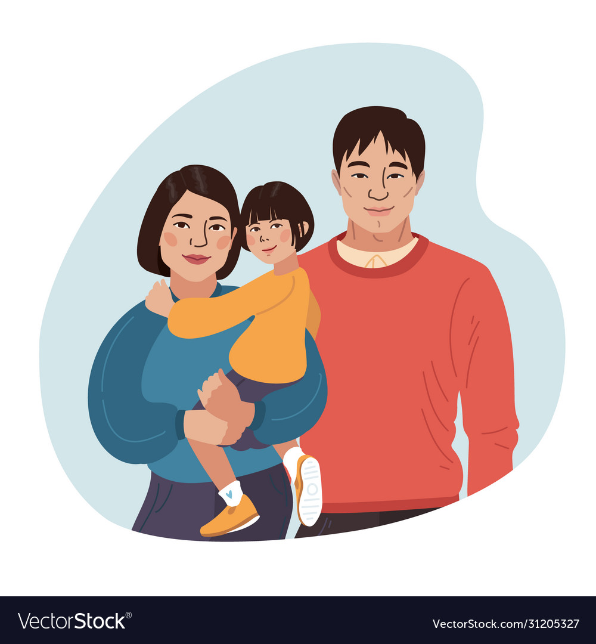


Staying Safe
Talk to adults you can trust- like a uniformed police officer, teacher or parent

Slide 4


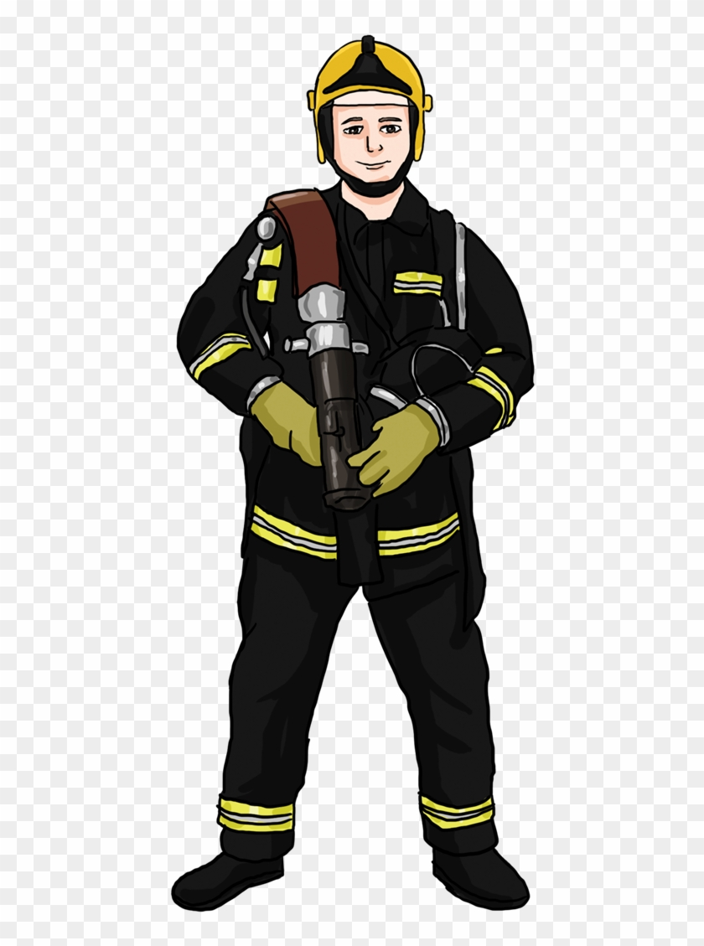
Staying Safe
Other trusted adults are- fire-fighters, nurses, shop assistants

Slide 5
Staying Safe
If you approached by a stranger or if you feel uncomfortable about a situation you must tell a trusted adult.
A stranger is someone you do not know, who is not a trusted adult.

Slide 6
Staying Safe
If you are lost, stay where you are, do not wander off. You will be found more easily if you stay put.
Make a noise, shout ‘Help’, attract attention in some way. This will help bring someone to find you.
If you are in a place where you can see a trusted adult, then ask them for help

Slide 7
Staying Safe
Video

Slide 8
Staying Safe
Always hold hands with your parent/carer
Do not run off when walking with your parents/ carers
Always make sure your parents/ carers know where you are at all times

