Slide 2

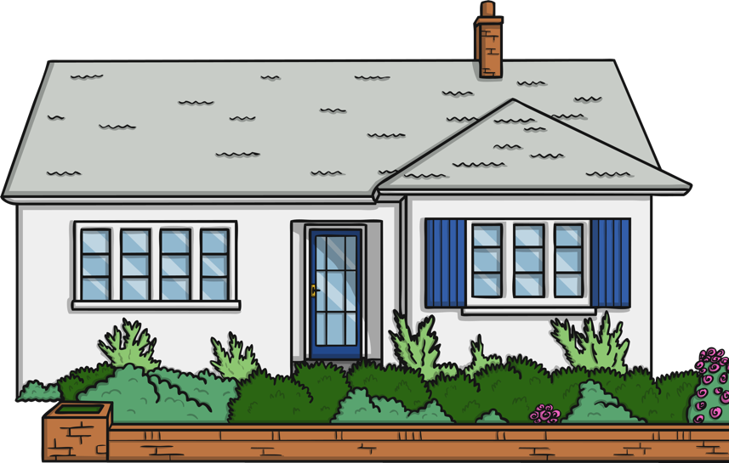

Which room would you like to go to?
kitchen
living room
bathroom

Slide 3
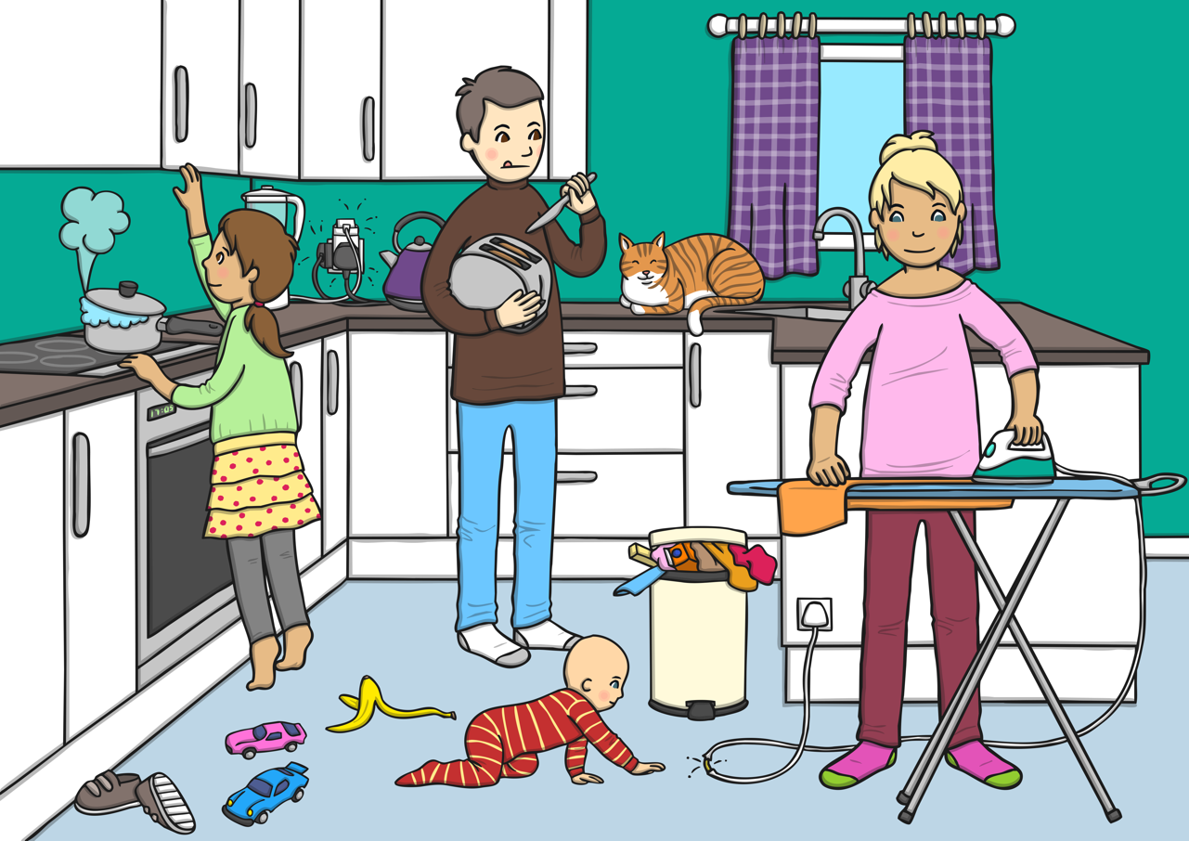

What dangers can you spot in the kitchen?
Click here to check.

Slide 4
back

Slide 5
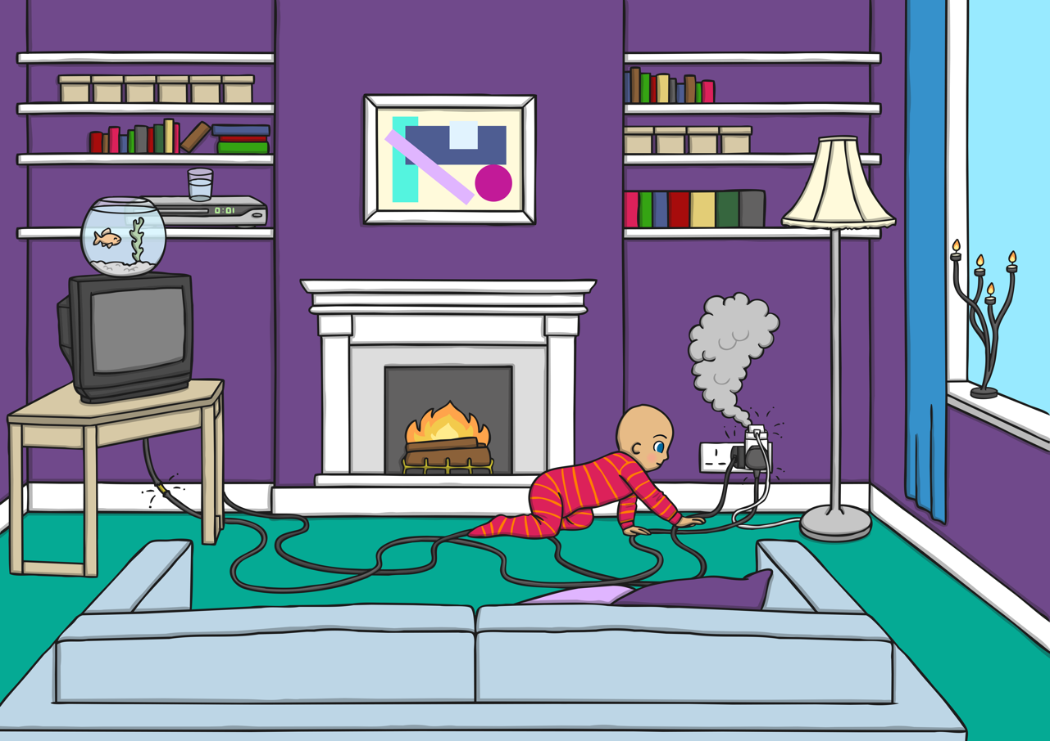

What dangers can you spot in the living room?
Click here to check.

Slide 6
back

Slide 7
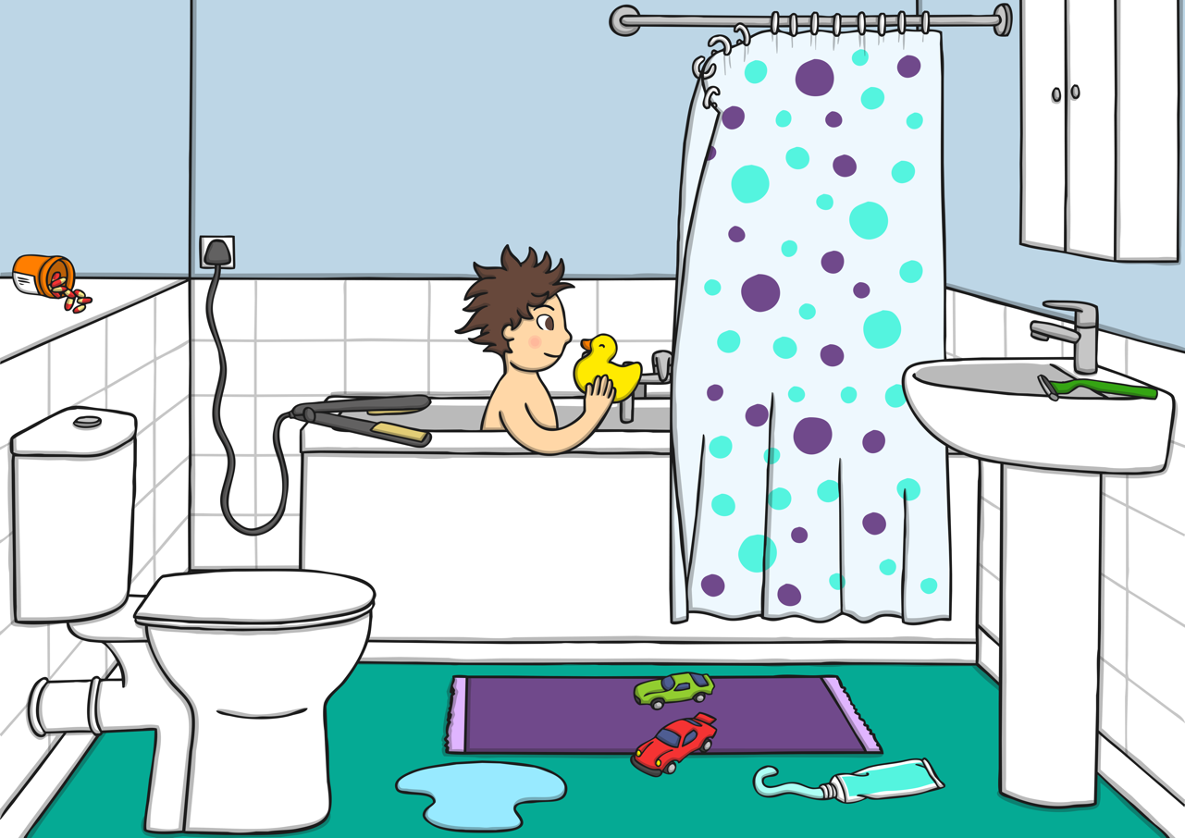

What dangers can you spot in the bathroom?
Click here to check.

Slide 8
back

