Slide 2
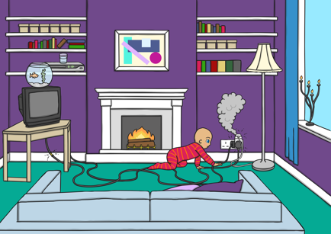
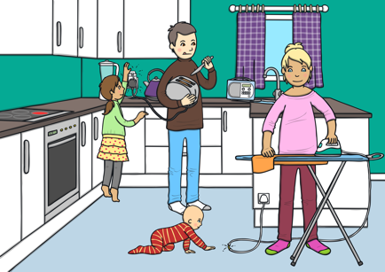
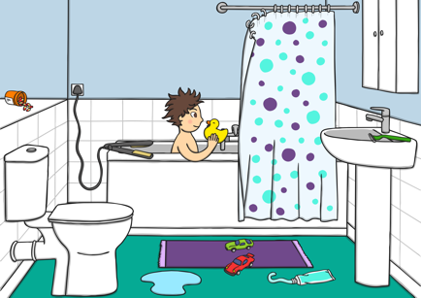
The Home
There are lots of different objects in the home.
There are some things we need to be careful of and let adults use. There are other things that can be dangerous if we don’t use them properly.

Slide 3
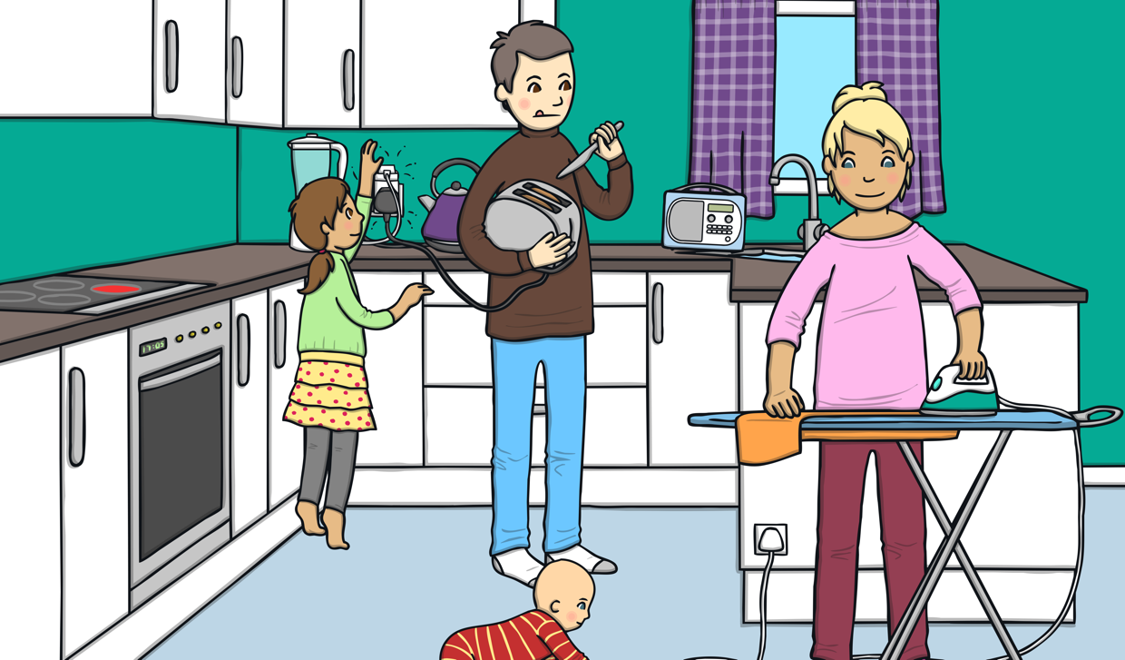
The Kitchen
There are some things in the kitchen that can be dangerous.
Can you think of any?

Slide 4
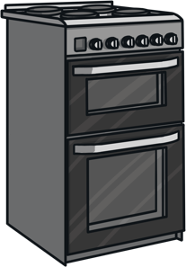
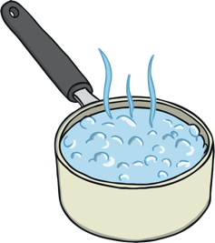

Safety in the Kitchen
Sharp objects: Knives, forks and other sharp objects are dangerous. Adults should use sharp knives as we could cut ourselves.
Heat in the kitchen: Ovens, grills, hobs and kettles are all very hot. We must always let adults open them and use them. We could burn our hands, or hurt our skin.
Hot water: Boiling water from the kettle, and from pots is really dangerous. The hot steam can burn and the hot water is dangerous.

Slide 5
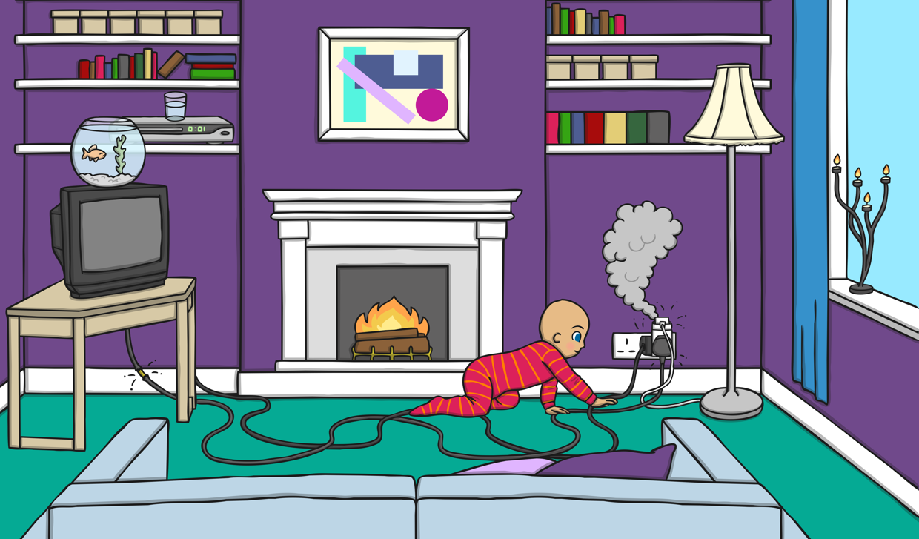
Safety in the Sitting Room
There can be dangers in the sitting room. We must be careful.
Can you think of any?

Slide 6
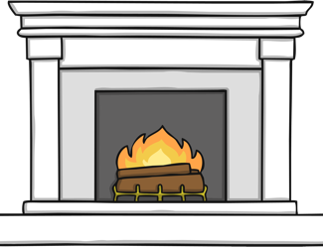
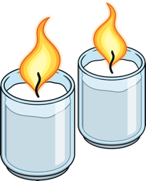

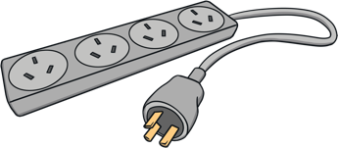
Dangers in the Sitting Room
Fireplaces: Fireplaces, with open fires and stoves can burn us. Don’t stand too close and never touch them.
Sockets: Sockets are used for electricity. Never stick anything into them, or touch them, especially if your hands are wet.
Trips and falls: We shouldn’t leave toys or other things on the floor. We might trip.
Candles: Never light candles. Adults can light them and should put them in a safe place.

Slide 7
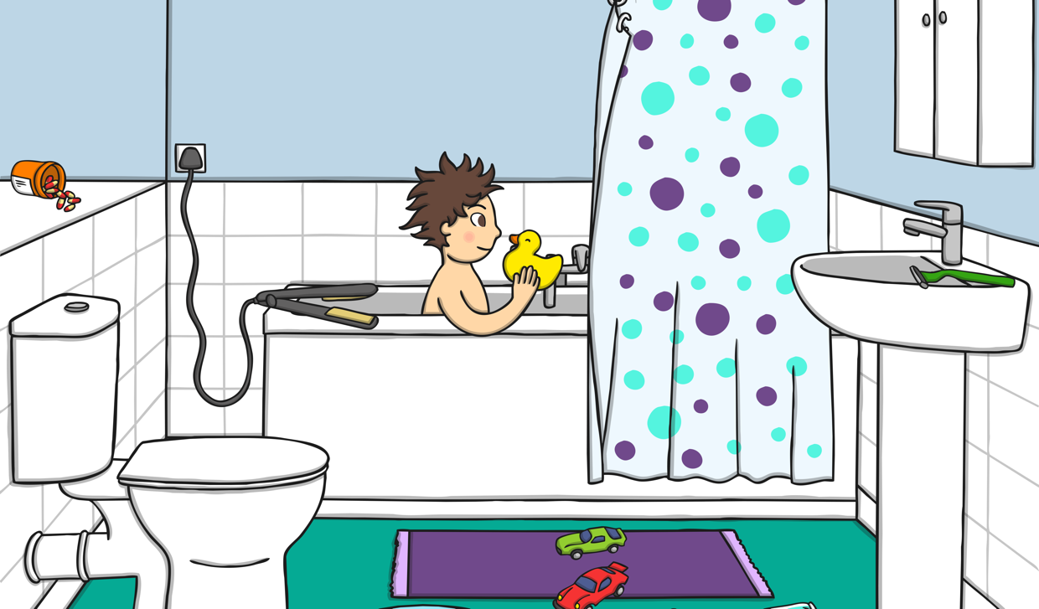
Safety in the Bathroom
Have a look at this bathroom
Can you think of any dangers?

Slide 8
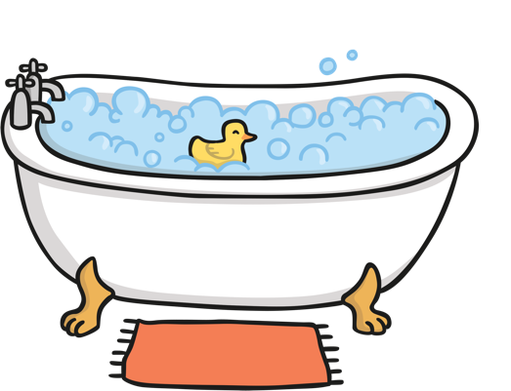


Dangers in the Bathroom
Water: Water can be dangerous. We must always have an adult
with us to use the bathtub.
Sharp objects: Razors are very sharp. Don’t touch them as they
could cut us.
Slips: Water on the floor can make us slip.

Slide 9
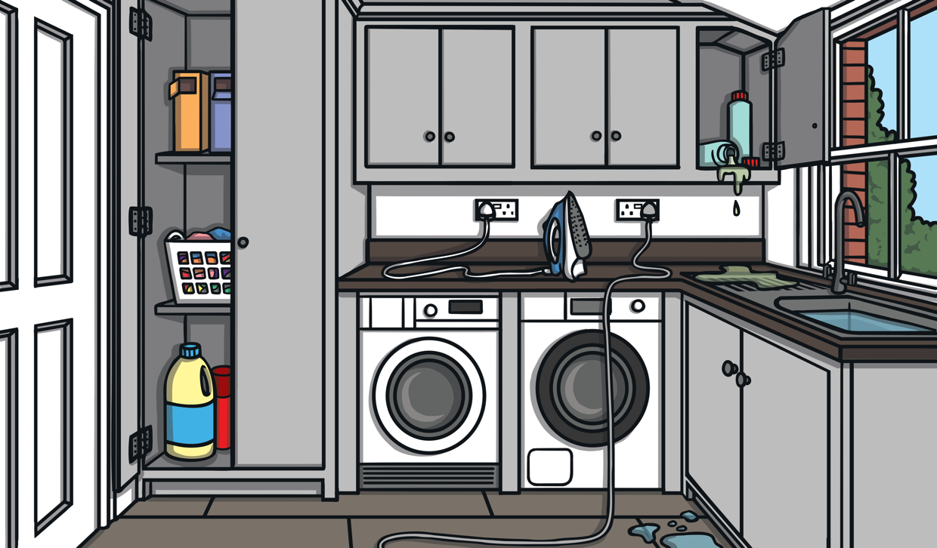
Safety in the Utility Room
There are some things in the utility room that can be dangerous.
Can you think of any?

Slide 10
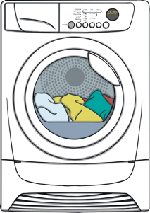
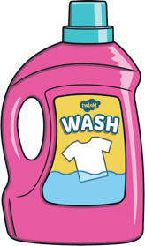
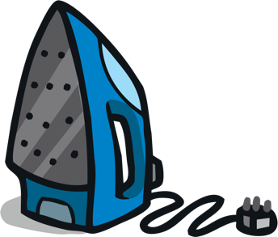
Dangers in the Utility Room
Machines:
Washing machines and tumble dryers should only be used by adults.
Cleaning products:
Don’t open bottles of cleaning products or washing detergents. Don’t put them in your mouth or on your skin.
The iron:
The iron is very hot and can burn us. Be careful not to trip on the lead.

Slide 11
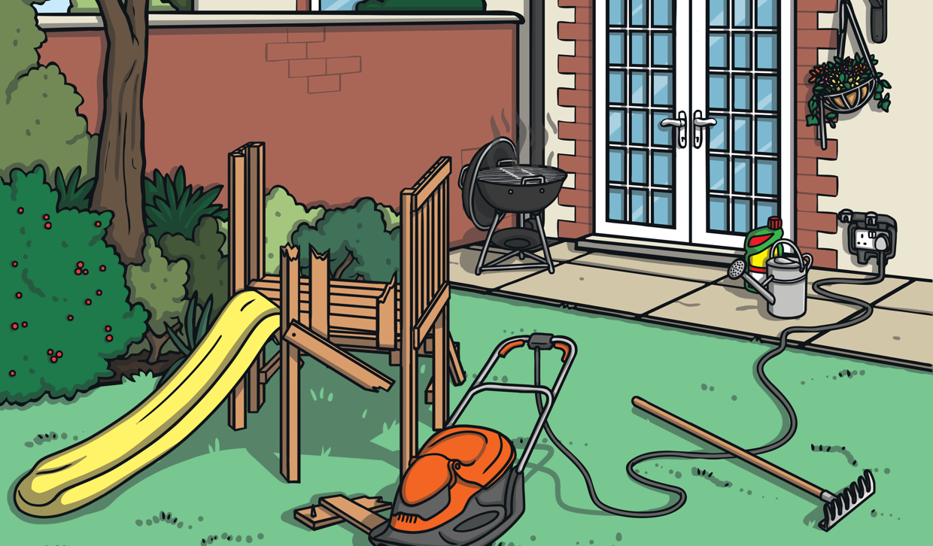
Safety in the Garden
There are some things in the garden that can be dangerous.
Can you think of any?

Slide 12
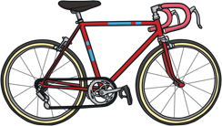
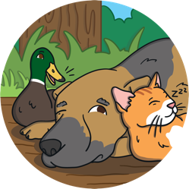
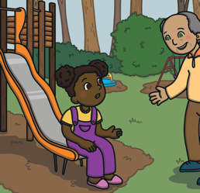

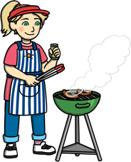
Dangers in the Garden
Dogs and animals: We need to be careful around dogs and other animals, especially ones we don’t know.
Strangers: When playing in the garden, we must always have an adult with us. We must never talk to strangers.
Trips: Toys and other items can make us trip in the garden. We should put them away once we are finished.
Bicycles and scooters: We should always wear a helmet when using bicycles and other toys that go fast.
Barbeque: Barbeques are very hot and can burn us.

Slide 13
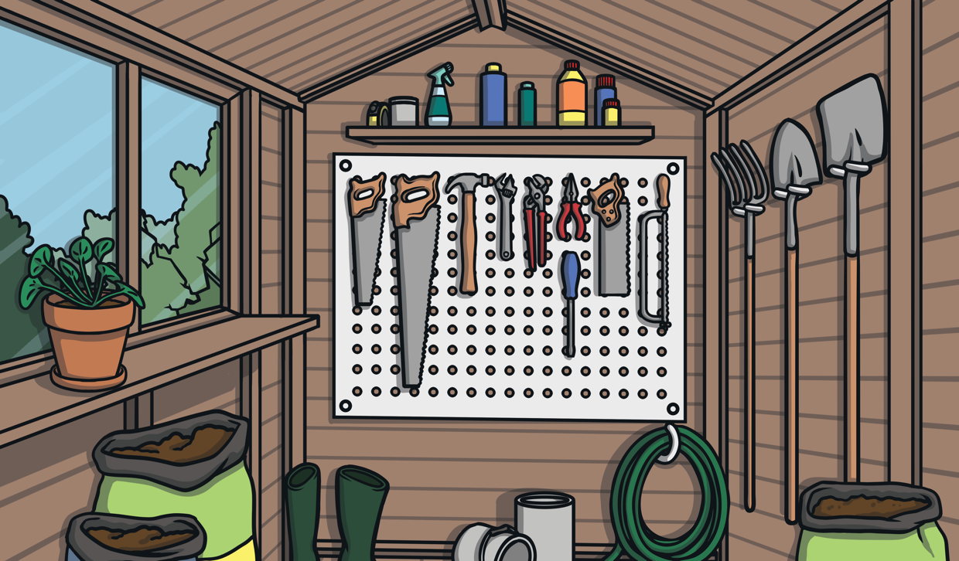
Safety in the Shed
There are some things in the shed that can be dangerous.
Can you think of any?

Slide 14
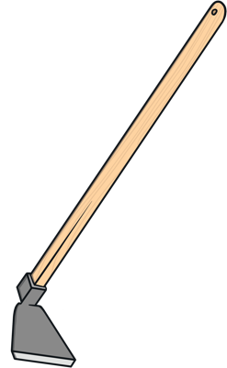
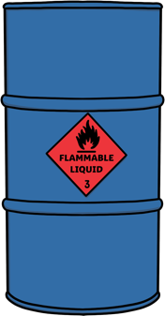
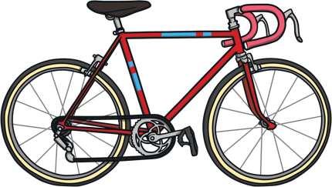
Dangers in the Shed
Tools: Garden tools can be sharp and should only be used by adults.
Chemicals: Sometimes people store chemicals in their sheds. Don’t open or touch chemicals.
Bicycles and other heavy objects: Heavy objects like chairs and bicycles could injure us if they fall on us.

Slide 15
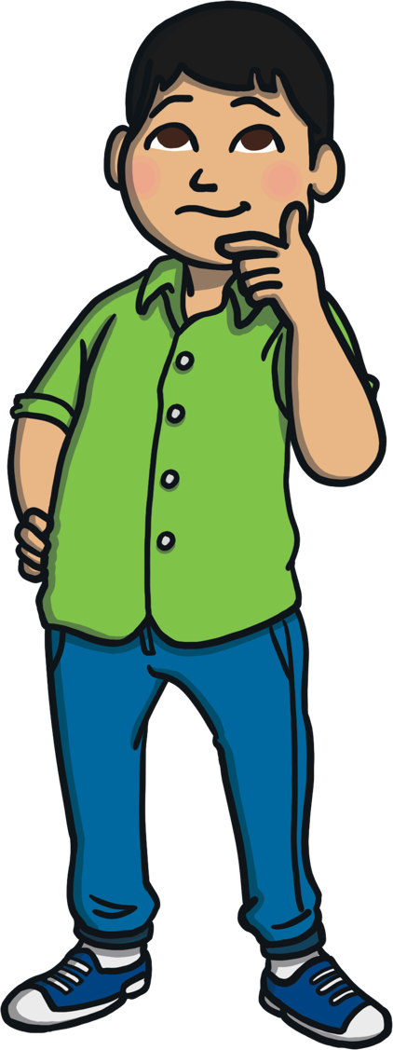
Remember
Sharp, hot objects are dangerous and should be used by adults.
Don’t open cleaning products, medicines or other chemicals. Never put them in your mouth, especially anything that we aren’t sure what it is.
Sockets and switches are used for electricity. Don’t touch them, especially if your hands are wet. Never stick anything into toasters
or sockets.
Tidy up behind you so that nobody trips and falls. Be careful if the ground is wet, or if there are leads or wires in the way.

