Slide 1


Slide 2
Keeping safe at home

Slide 3
Who keeps you safe at home?

Slide 4
Staying Safe in the Home

Slide 5
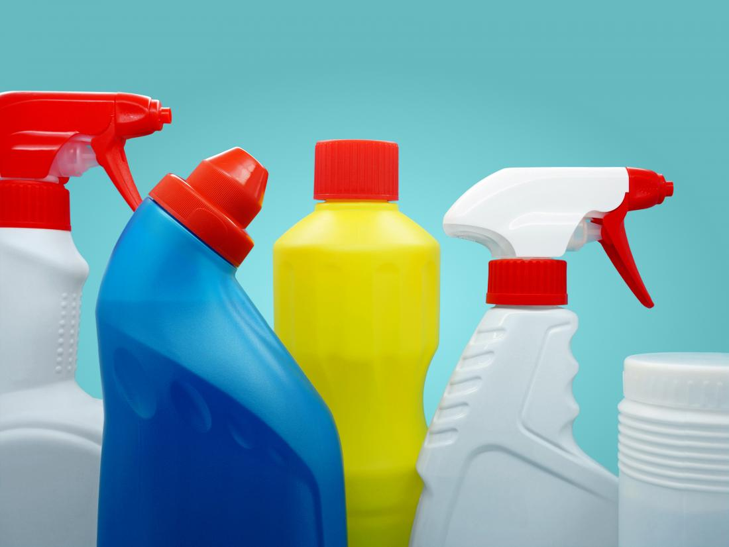

Harmful Substances
These are things that can hurt us if we eat them or sometimes if we just touch them.

Slide 6
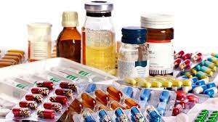
Medicines
You should never give medicine to yourself
Who should give you medicine?
What are medicines for?

Slide 7
How can you keep safe at home?

Slide 8
Sharp, hot objects are dangerous and should be used by adults only.
Do not open cleaning products, medicines or other chemicals.
Do not touch electrical sockets or switches.
Tidy up so nobody trips or falls over your things.
Water can be dangerous.

