Slide 1
Who keeps us safe in school?

Slide 2
Safeguarding Team
Mrs Aldridge
Mr Tee
Mrs Maltby
Miss Phillips
Mrs Hafeez
Mrs Lewis-Gordon

Slide 3
Teachers and TAs
Talk to a teacher if…
Someone is upsetting you
Something has happened at home that has made you sad or worried
Somebody outside of school has made you sad or worried
If you think anyone has made you do something that didn’t make you feel comfortable
You want to ask about something

Slide 4
Bobbersmill Site
All external doors and gates have access controls or locks
All staff members have identity badges
Visitors have to sign in and wear a badge given to them by the office
CCTV cameras around the school grounds

Slide 5
Office Staff
Check that you are in school and ring your parents if you are not
Ring your parents if need to go home sick
Talk to your parents if there is a problem

Slide 6
Mid-day Supervisors

Slide 7
Mid-day supervisors
They can help…
When you think you or someone else might be getting bullied
When you fall out with your friends
When you or someone else feels angry
When you feel lonely
Talk to them

Slide 8
Parent Support Workers
Work with parents and carers to ensure children are getting the most out of school and are safe and happy
Provide support and information for parents and carers on a range of issues – these can include health, housing, welfare rights, education or any other concerns
Home visits to children who are not attending school

Slide 9


Slide 10
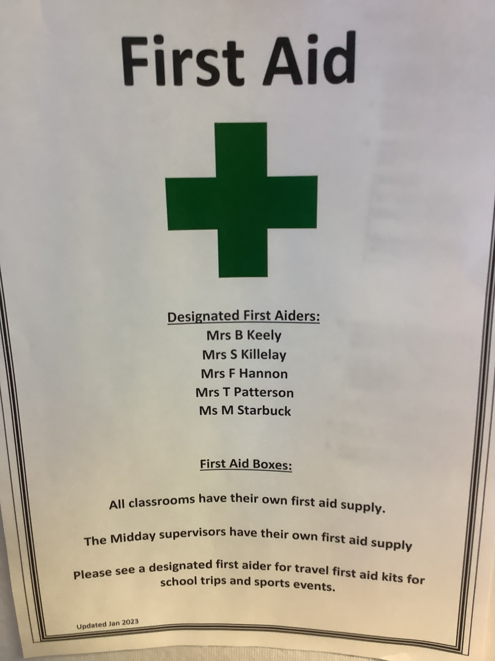

Slide 11
You

Slide 12
How to keep yourself safe in school
Talk to an adult if you are sad, worried or think someone is bullying you
Let an adult know if you think someone else may be sad, worried or being bullied
Only go where you are told to go-if you walk home-go straight home
Follow the school rules

